Slide 1
Tutorial
(Axis2 Web Service – Eclipse WTP 2.0)
2009. 02. 04
CODELABOR
Shin Sang Jae (codelabor@gmail.com)

Slide 2
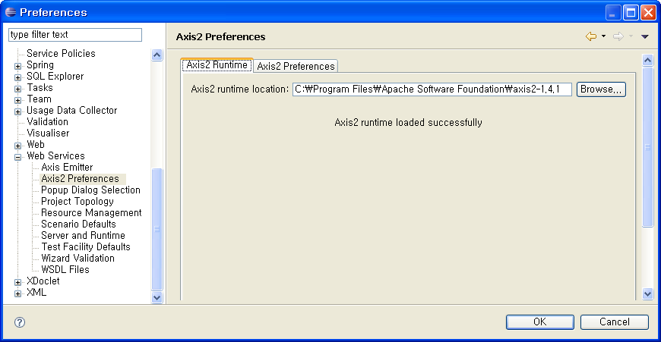
Eclipse Configuration
Setup
Install Axis2
Eclipse > Window > Preferences > Web Services > Axis2 Preferences
Browse the Axis2 Runtime Location

Slide 3
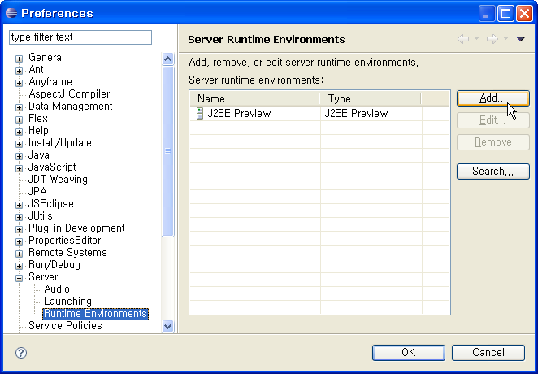
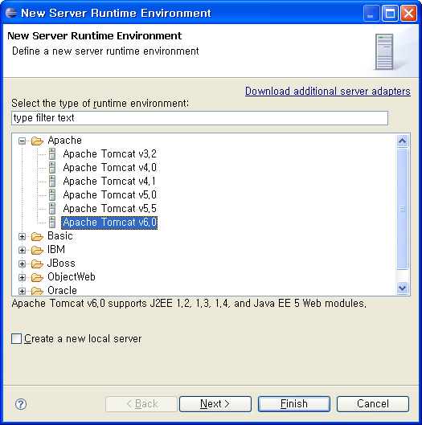
Eclipse Configuration
Setup
Reference
http://www.eclipse.org/webtools/community/tutorials/BottomUpAxis2WebService/bu_tutorial.html
Install Tomcat
http://code.google.com/p/codelabor/source/browse/trunk/installation-guide/Installation%20Guide%20(Servlet%20Container%20-%20Tomcat%206.0.18).ppt
Eclipse > Window > Preferences > Server > Runtime Environments
Add > New Server Runtime Environment > Apache > Apache Tomcat v6.0

Slide 4
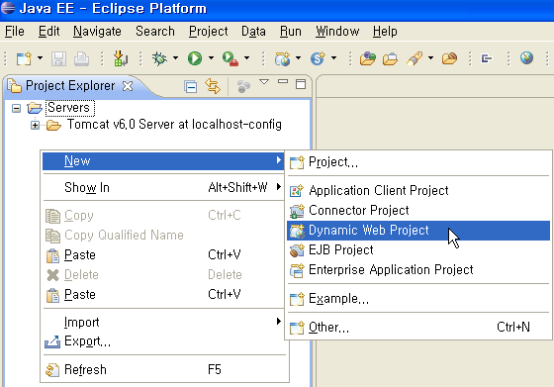
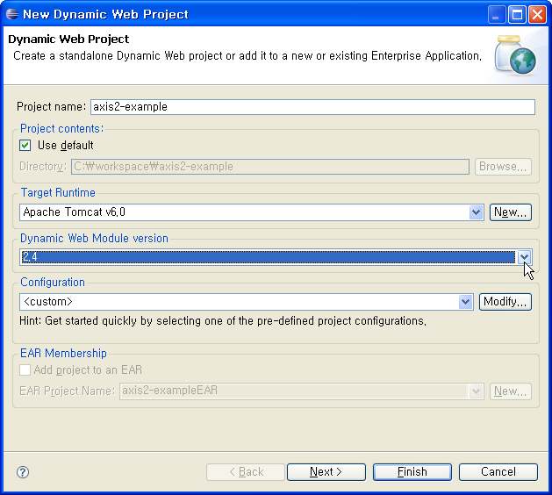
Web Service Provider
Create Project
Eclipse > File > New > Dynamic Web Project
Project Name: axis2-example
Dynamic Web Module version: 2.4

Slide 5
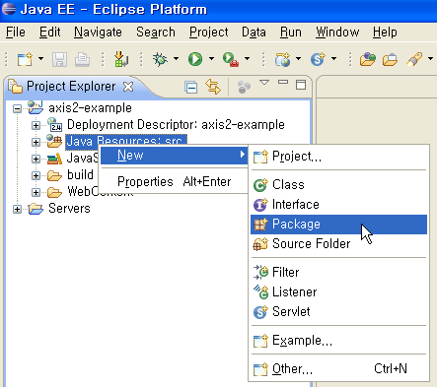
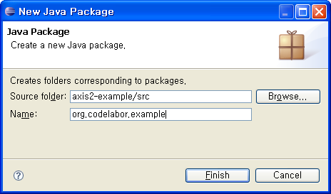
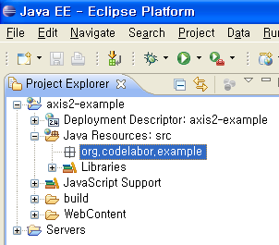
Web Service Provider
Create Package
Package: org.codelabor.example

Slide 6
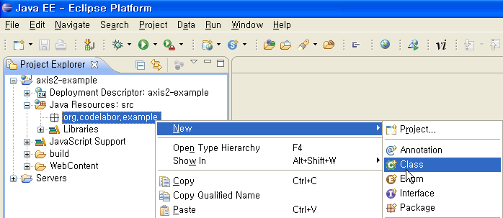
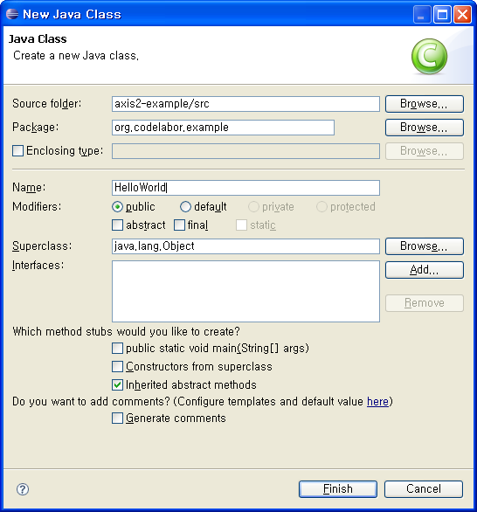
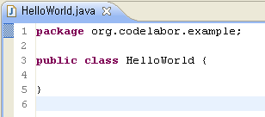
Web Service Provider
Create Class
New > Class
Name: HelloWorld

Slide 7
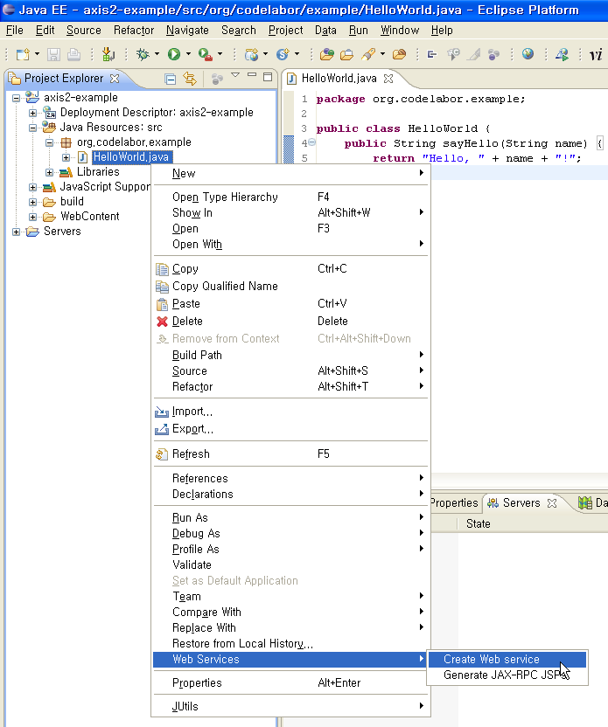
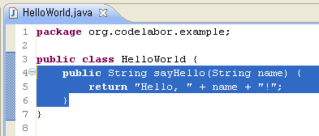
Web Service Provider
Create Class
method: String sayHello(String name)
New > Web Services > Create Web service

Slide 8
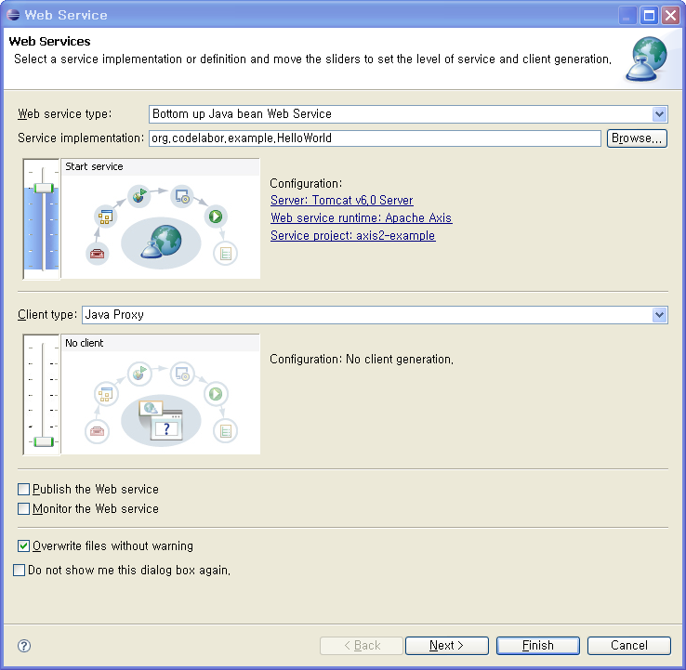
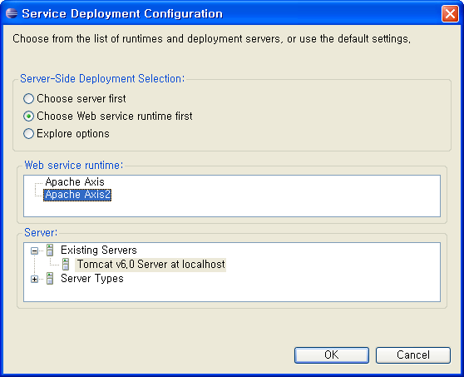
Web Service Provider
Web Services Configuration
Change Web Service runtime: Apache Axis2

Slide 9
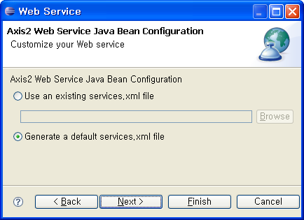
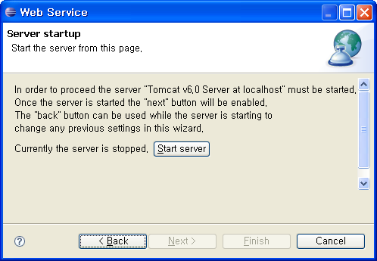
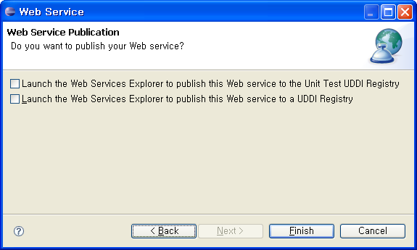
Web Service Provider
Web Services Configuration
Select Generate a default services.xml file
Start server

Slide 10
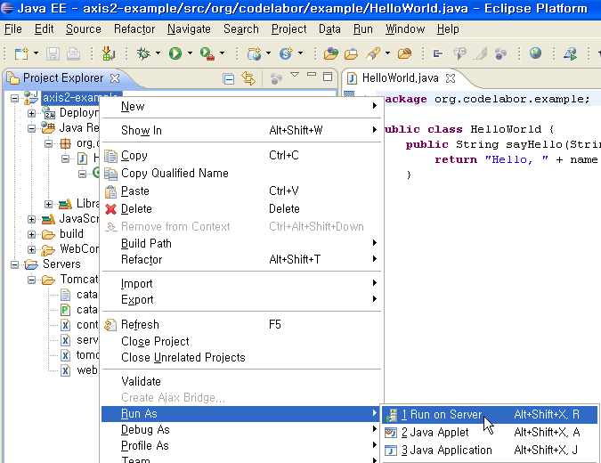
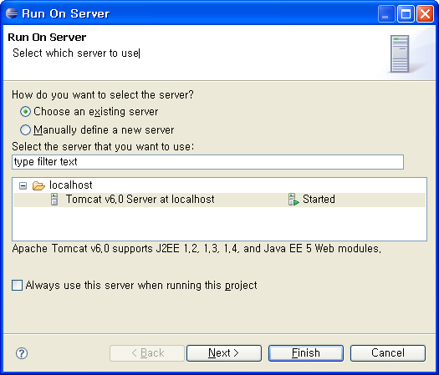
Web Service Provider
Web Services Configuration
axis2-example > Run As > Run on Server

Slide 11
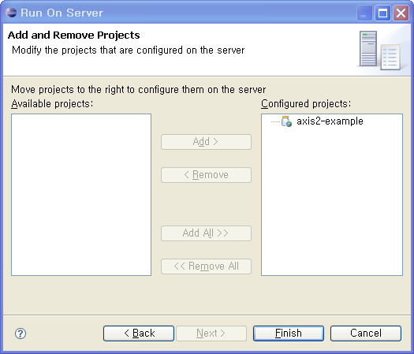
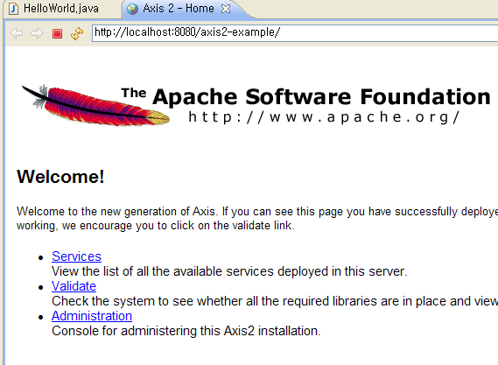
Web Service Provider
Run Server
axis2-example > Run As > Run on Server

Slide 12
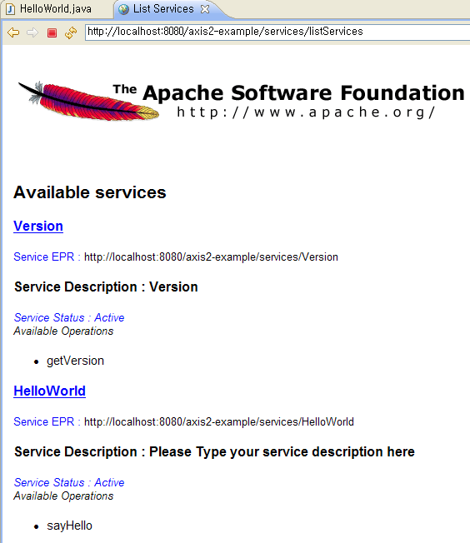
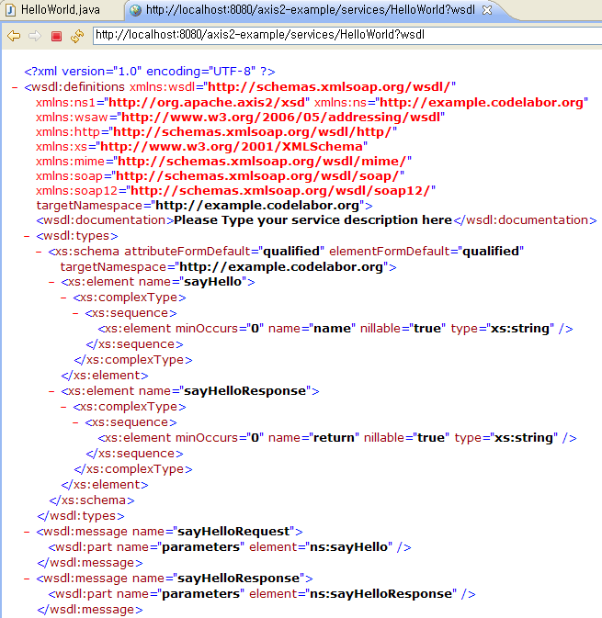
Web Service Provider
Check WSDL
Services > HelloWorld
WSDL URL: http://localhost:8080/axis2-example/services/HelloWorld?wsdl

Slide 13
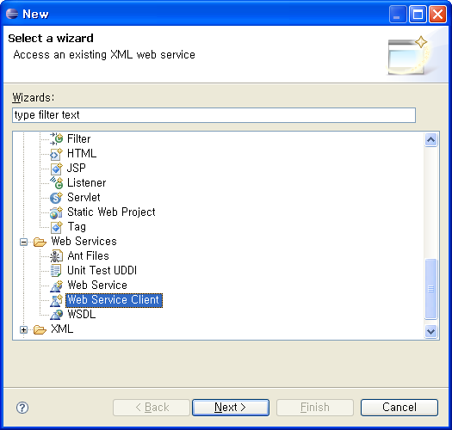
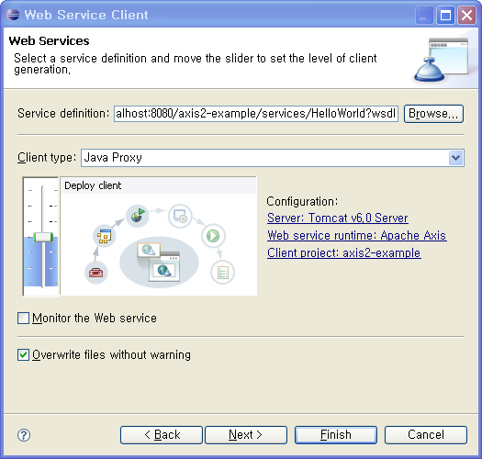
Web Service Consumer
Web Services Configuration
New > Other > Web Service Client
Service definition
http://localhost:8080/axis2-example/services/HelloWorld?wsdl

Slide 14
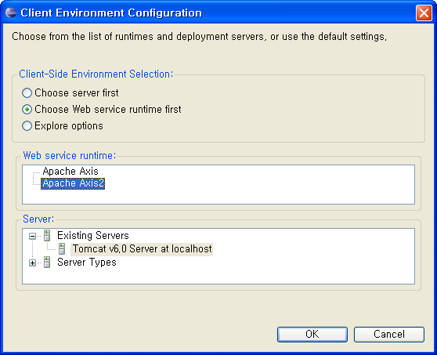
Web Service Consumer
Web Services Configuration
Change Web Service runtime: Apache Axis2

Slide 15
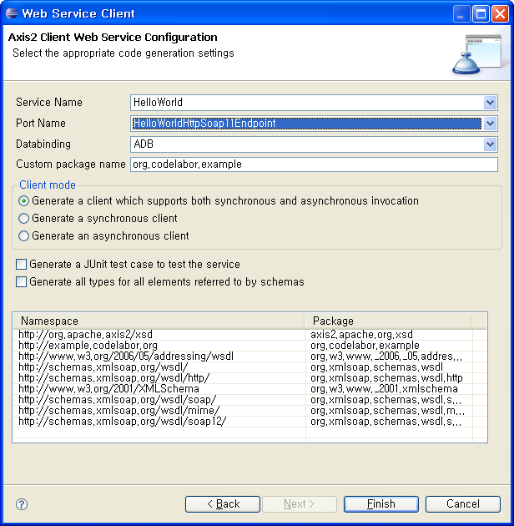
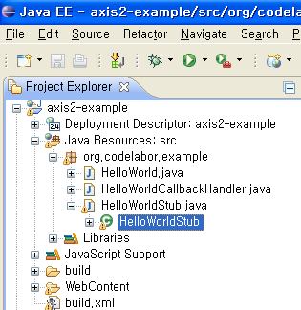
Web Service Consumer
Create Class
Port Name: HelloWorldHttpSoap11Endpoint

Slide 16
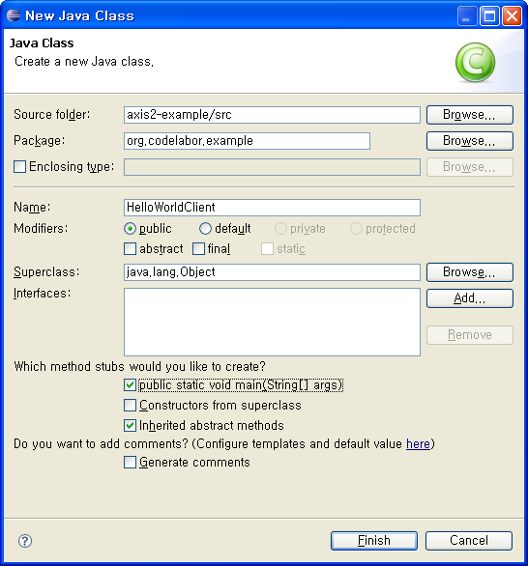
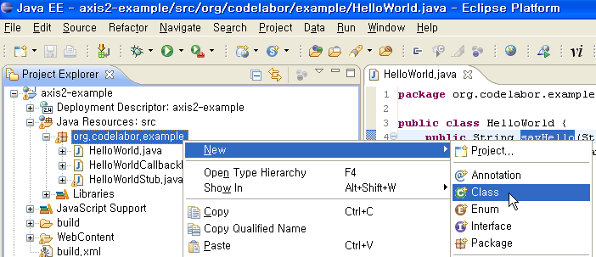
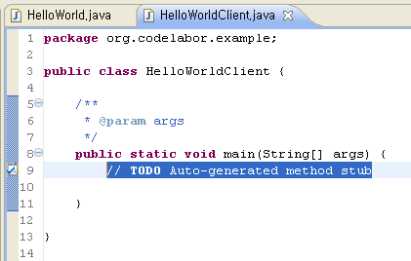
Web Service Consumer
Create Class
New > Class
Name: HelloWorldClient
Check public static void main(String[] args)

Slide 17
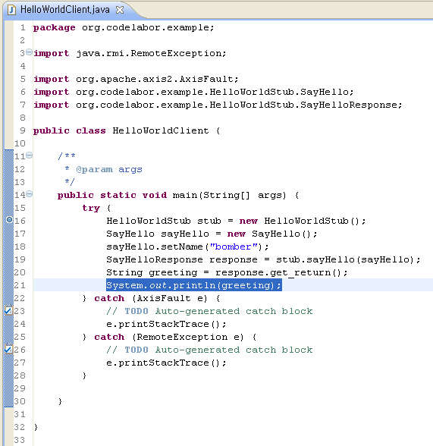
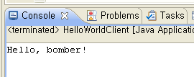
Web Service Consumer
Test Client
Code / Test Client

